Slide 1

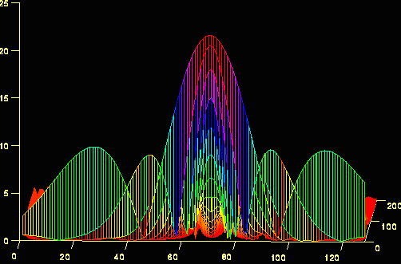
Image Enhancement In Frequency Domain

Slide 2




Image Operations in Different Domains
1) Gray value (histogram) domain
2) Spatial (image) domain
3) Frequency (Fourier) domain
- Histogram equalization, specification, etc...
- Average filter, median filter, gradient, laplacian, etc…
+
3 X 3 Average
=
5 X 5 Average
Original histogram
Equalized histogram
Noisy image
(Salt & Pepper noise)
Original image
Gradient magnitude
Blurry Image
Laplacian
Sharpened Image
7 X 7 Average
Median

Slide 3
Image Enhancement
Purposes: To make an image better appealing and easier to deal with than the original image
Three categories:
Spatial domain methods: operate on the images itself,
Point processing, e.g., image averaging; logic operation; contrast stretching ...
Mask processing, e.g., filtering or mask operation, (blurring, median

Slide 4
Image Enhancement …
Frequency domain methods: work on the Fourier transformed output of the image, examples: from the convolution theory
g(x,y) = f(x,y) ⊗ h(x,y)
=> G(u,v) = F(u,v) • H(u,v)
=> certain properties of F(u,v) can be
emphasized into G(u,v)
=> spatial domain g(x,y) = F⁻¹{G(u,v)}
Combination of the above two categories
Notes:
Frequency methods: the Fourier Transform
FREQUENCY refers to the RATE OF REPETITION of some periodic event. In imaging, SPATIAL FREQUENCY is the rate at which the brightness of an image changes with position in space. High spatial frequencies correspond to rapidly varying, fine detail; low spatial frequencies correspond to slowly changing brightness.
Theory shows that any varying signal (1D or 2D) can be decomposed or TRANSFORMED into a series of simple periodic variations. The Fourier Transform is one of the best known techniques for performing such a decomposition, and decomposes the signal into a set of sine waves of different frequencies.

Slide 5
Why Do Transforms?
Fast computation
E.g., convolution vs. multiplication for filter with wide support
Conceptual insights for various image processing
E.g., spatial frequency info. (smooth, moderate change, fast change, etc.)
Obtain transformed data as measurement
E.g., blurred images, radiology images (medical and astrophysics)
Often need inverse transform
May need to get assistance from other transforms
For efficient storage and transmission
Pick a few “representatives” (basis)
Just store/send the “contribution” from each basis

Slide 6
Listening to an orchestra, you can distinguish between different instruments, although the sound is a SINGLE FUNCTION !
Flute
Tabla
Sitar

Slide 7
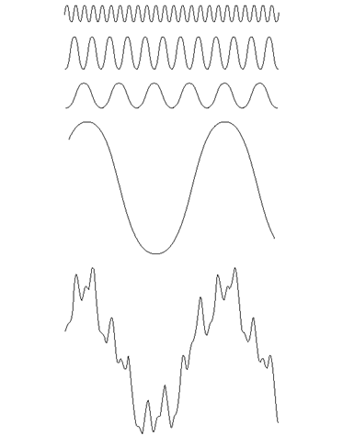
Fourier Series
Any function that periodically repeats itself can be expressed as the sum of sines and/or cosines of different frequencies, each multiplied by a different coefficients. This sum is called a Fourier series.
Notes:
For example, a square wave (which might represent a pair of sharp edges in an image) can be thought of as the combined sum of a set of sine waves at frequencies 1f, 2f, 3f, .. (f is the frequency of the square wave). The more sine waves included in the summation, the more the resulting sum resembles the original square wave.
The set of waves used to represent a waveform as frequency components is referred to as its SPECTRUM. A complete spectrum specifies:
the AMPLITUDE of each frequency, which is related to the amount of ENERGY in the signal at that frequency, and:
how it must be positioned with respect to the other frequency components (PHASE).
Waveforms other than the square wave just discussed can be represented by their own characteristic spectra, with differing amplitudes and phases for the contributing frequency components.
The Fourier Transform is a mathematical technique for determining the amplitude and phase of the spectral components of a wave.

Slide 8
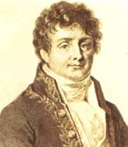
Joseph Fourier (1768-1830)
Had crazy idea (1807):
Any periodic function can be rewritten as a weighted sum of Sines or Cosines of different frequencies.
Don’t believe it?
Neither did Lagrange, Laplace, Poisson and other big wigs
Not translated into English until 1878!
But it’s true!
called Fourier Series
Possibly the greatest tool
used in Engineering

Slide 9
Periodic Signals
A continuous-time signal x(t) is periodic if:
x(t + T) = x(t)
Fundamental period
T₀, of x(t) is smallest T satisfying above equation.
Fundamental frequency: f₀ = 1/T₀
Fundamental angular frequency:
ω₀ = 2π/T₀ = 2πf₀

Slide 10
Fourier Series
y(x) = A sin(fx + p)
Any mathematical function that periodically repeats itself can be expressed as a sum of sines &/or cosines with different amplitudes A, frequencies f, and phases p.
It does not matter how complicated the function is – as long as it is periodic (& meets certain mathematical conditions), it can be represented by such a sum.
Even functions that are not periodic (but whose area under the curve is finite) can be expressed as the integral of sines &/or cosines multiplied by a weighting function.

Slide 11
A sum of sines and cosines
=
A
sin(x)
A
3 sin(x)
+ 1 sin(3x)
B
A+B
+ 0.8 sin(5x)
C
A+B+C
+ 0.4 sin(7x)
D
A+B+C+D
Notes:
For example, a square wave (which might represent a pair of sharp edges in an image) can be thought of as the combined sum of a set of sine waves at frequencies 1f, 2f, 3f, .. (f is the frequency of the square wave). The more sine waves included in the summation, the more the resulting sum resembles the original square wave.
The set of waves used to represent a waveform as frequency components is referred to as its SPECTRUM. A complete spectrum specifies:
the AMPLITUDE of each frequency, which is related to the amount of ENERGY in the signal at that frequency, and:
how it must be positioned with respect to the other frequency components (PHASE).
Waveforms other than the square wave just discussed can be represented by their own characteristic spectra, with differing amplitudes and phases for the contributing frequency components.
The Fourier Transform is a mathematical technique for determining the amplitude and phase of the spectral components of a wave.

Slide 12
Amplitude and Phase
The spectrum is the set of waves representing a signal as frequency components. It specifies for each frequency:
The amplitude (related to the energy)
The phase (its ‘position’ relative to other frequencies)
Notes:
The Fourier Transform in 2D images
The same ideas are valid for 2-dimensional spatial signals (images). The spectrum now represents the amplitudes and phases of sine waves corresponding to the x and y spatial directions of the image.
Duality of spatial and frequency representations
Given any image, we can deduce its spectrum (using the Fourier Transform), and, correspondingly, given a spectrum, we can deduce the original signal. The spectrum is interchangeable with the original image, containing the same information, but in a different arrangement.
For this duality to hold, we must take account of both the amplitude information and the phase information in the spectrum. Some applications may use only the amplitude information, simply discarding the phase information, on the basis that only the quantity (or energy) of each frequency, and not its phase, is important. Another justification sometimes stated for ignoring the phase information is that it is often difficult to interpret in a meaningful way. Often, in image processing, we may look at a graph or display of the square of the amplitudes (known as the POWER SPECTRUM) to get some feel for the frequencies involved. It is vital to remember that without the additional phase information, the original image cannot be reconstructed.

Slide 13
Fourier Transform
We want to understand the frequency w of our signal. So, let’s reparametrize the signal by w instead of x:
f(x)
Fourier
Transform
F(ω)
For every ω from 0 to inf, F(ω) holds the amplitude A and phase φ of the corresponding sine
How can F hold both? Complex number trick!
F(ω)
Inverse Fourier
Transform
f(x)

Slide 14
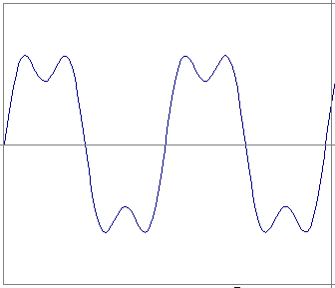
Time and Frequency
example : g(t) = sin(2pf t) + (1/3)sin(2p(3f) t)

Slide 15
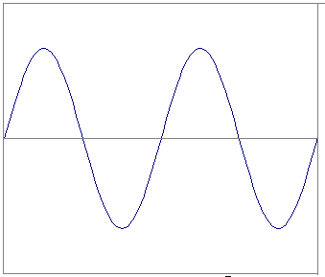
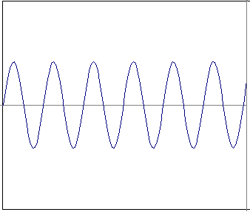
Time and Frequency
example : g(t) = sin(2pf t) + (1/3)sin(2p(3f) t)
=
+

Slide 16
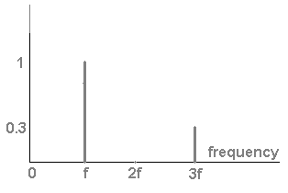
Frequency Spectra
example : g(t) = sin(2pf t) + (1/3)sin(2p(3f) t)
=
+

Slide 17

The Continuous Fourier Transform
Represent the signal as an infinite weighted sum of an infinite number of sinusoids
F(u) is called the Fourier Transform of f(t). We say that f(t) lives in the “time domain,” and F(u) lives in the “frequency domain.” u is called the frequency variable.

Slide 18
The Inverse Fourier Transform
Given F(u), f(t) can be obtained by the inverse Fourier transform (IFT)

Slide 19
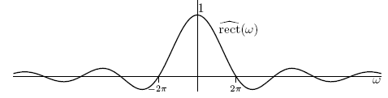
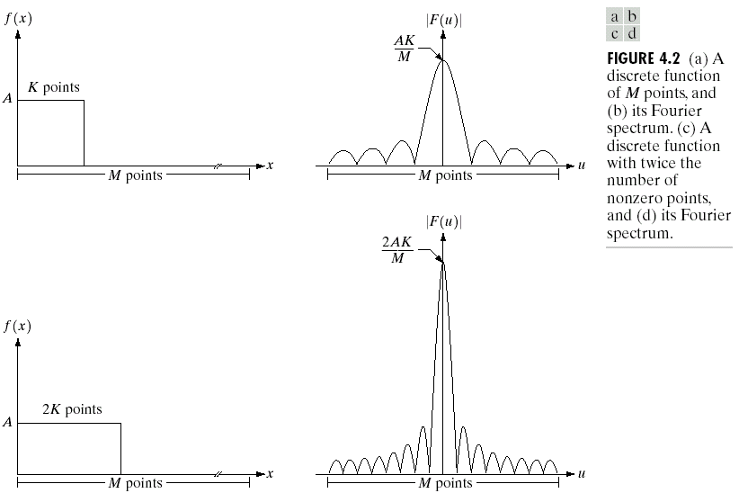
AW
Fourier Transform
-1/W
1/W
The Fourier spectrum tells us:
The pulse is made up of infinite frequencies.
The frequency component at 0 has the maximum amplitude.
At higher frequencies, the amplitude goes on decreasing.
If we add up all these frequencies (u), we get back the original signal.
Fourier Spectrum

Slide 20
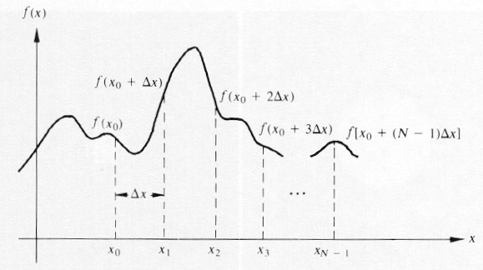
Discrete Fourier Transform (DFT)
A continuous function f(x) is discretized as:
Notes:
The discrete Fourier Transform
The theory just discussed applies to CONTINUOUS FUNCTIONS. However, an image processed by computer is defined as a discrete set of values. A corresponding theory applies in these cases. The discrete Fourier Transform (DFT), and the computational techniques employed to determine it are covered in other sheets.
When we compute the DFT of a 2D image, the spectrum that results is a pair of 2-dimensional arrays representing the REAL and IMAGINARY parts from which the amplitude and phase can be deduced.
Sampling effects
Just as a digitised image is an approximation to the natural image from which it was obtained, so is the DFT (i.e. the spectrum) of an image an approximation. This arises for two main reasons:
Firstly, the DFT assumes that the digital image is just one period of an infinite periodic function. If values at the opposite edges are not the same, discontinuities are seen. They can be reduced by smoothing the image down to 0 towards its edges.
High frequency components in the original image can sometimes be mistaken for low frequency components in the digitised image. The high frequency is said to be ALIASED with the low frequency. The solution is to filter the image (before digitising) to impose a limit on the highest frequency present.

Slide 21
Discrete Fourier Transform (DFT)
Let x denote the discrete values (x=0,1,2,…,M-1), i.e.
then

Slide 22
Discrete Fourier Transform (DFT)
The discrete Fourier transform pair that applies to sampled functions is given by:
u=0,1,2,…,M-1
and
x=0,1,2,…,M-1

Slide 23

Example: A simple one-dimensional DFT

Slide 24
Polar Coordinate Representation of FT
The Fourier transform of a real function is generally complex and we use polar coordinates:
Polar coordinate
Magnitude:
Phase:
Power spectrum:

Slide 25
How to compute F(u)?
u =[0,1,2, …, M-1]
Substitute u = 0 in the exponential term & then sum for all values of x.
Next substitute u = 1 in the exponential & repeat the summation over all values of x.
Repeat this process for all M values of u in order to obtain the complete Fourier transform.

Slide 26

DFT: Example
Find the DFT of f(x) = {0, 1, 2, 1}
DFT Matrix Method
Twiddle Factor
A new factor defined as

Slide 27

DFT: Example
The DFT now reduces to
To solve this equation, form a square matrix W_{M} of size MxM
The equation then reduces to
F = W . f

Slide 28
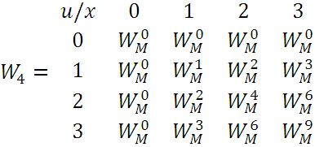
Here W_{M} will be a 4x4 matrix

Slide 29
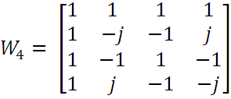
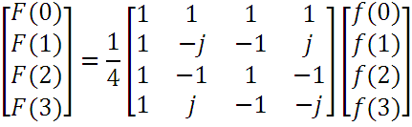

Slide 30
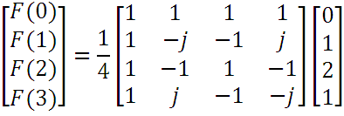
F(0) = 1 F(1) = -1/2
F(2) = 0 F(3) = -1/2
The size of the DFT matrix depends on the number of points in the input sequence.

Slide 31
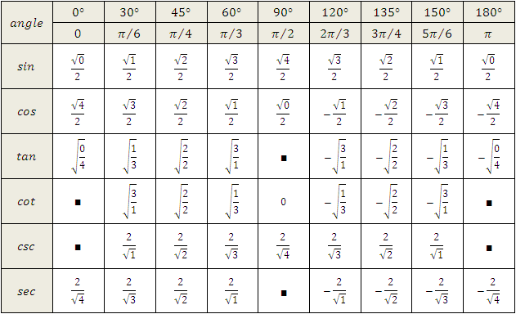

Slide 32
2-D Discrete Fourier Transform …
What do we mean by frequency in an image?
Low frequency region
High frequency region
Low frequency region

Slide 33
Why is FT Useful?
Remove undesirable frequencies from a signal.
Easier and faster to perform certain operations in the frequency domain than in the spatial domain.
g(x,y) = f(x,y) ⊗ h(x,y)
=> G(u,v) = F(u,v) • H(u,v)
=> certain properties of F(u,v) can be
emphasized into G(u,v)
=> spatial domain g(x,y) = F⁻¹{G(u,v)}

Slide 34
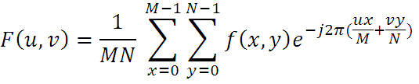
Properties of DFT
The Separability Property
A 2-D DFT can be separated into two 1-D DFT

Slide 35


Properties of DFT …
We can rearrange the terms as follows

Slide 36
(0,0)
y
(0,0)
v
Row Transformation
f(x,y)
F(x,v)
x
x
(0,0)
v
F(u,v)
Column Transformation
u

Slide 37
Properties of DFT …
The Translation Property
If f(x,y) is multiplied by an exponential, the original Fourier Transform, F(u,v), gets shifted in frequency by f(u-u₀, v-v₀)

Slide 38
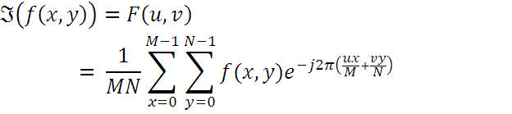
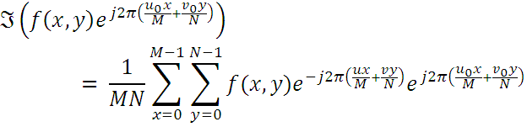

Slide 39



= F(u-u₀, v-v₀)
Thus, if
Then,

Slide 40


What happens when u₀ = M/2 & v₀ = N/2
Why?
For an M x N image, what are the coordinates of the centre pixel?
Since (x + y) is an integer
So sinΠ(x+y) = 0 & cosΠ(x+y) is 1 if (x+y) is even & -1 if it is odd

Slide 41

F(0, 0) is at the origin
F(M/2, N/2) is at the origin

Slide 42
A common practice …
Multiply the i/p image function by (-1)^{x + y} prior to computing the Fourier transform
This shifts the origin of F(u, v) to frequency coordinates (M/2, N/2),which is the centre of the M x N area occupied by the 2-DFT

Slide 43
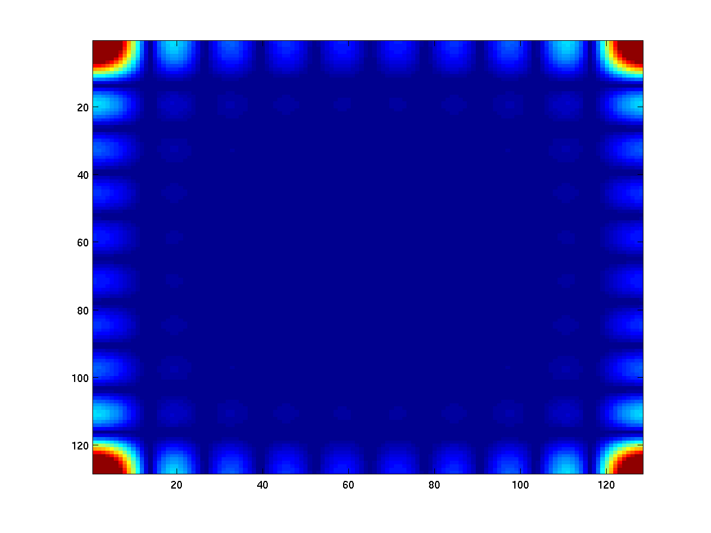
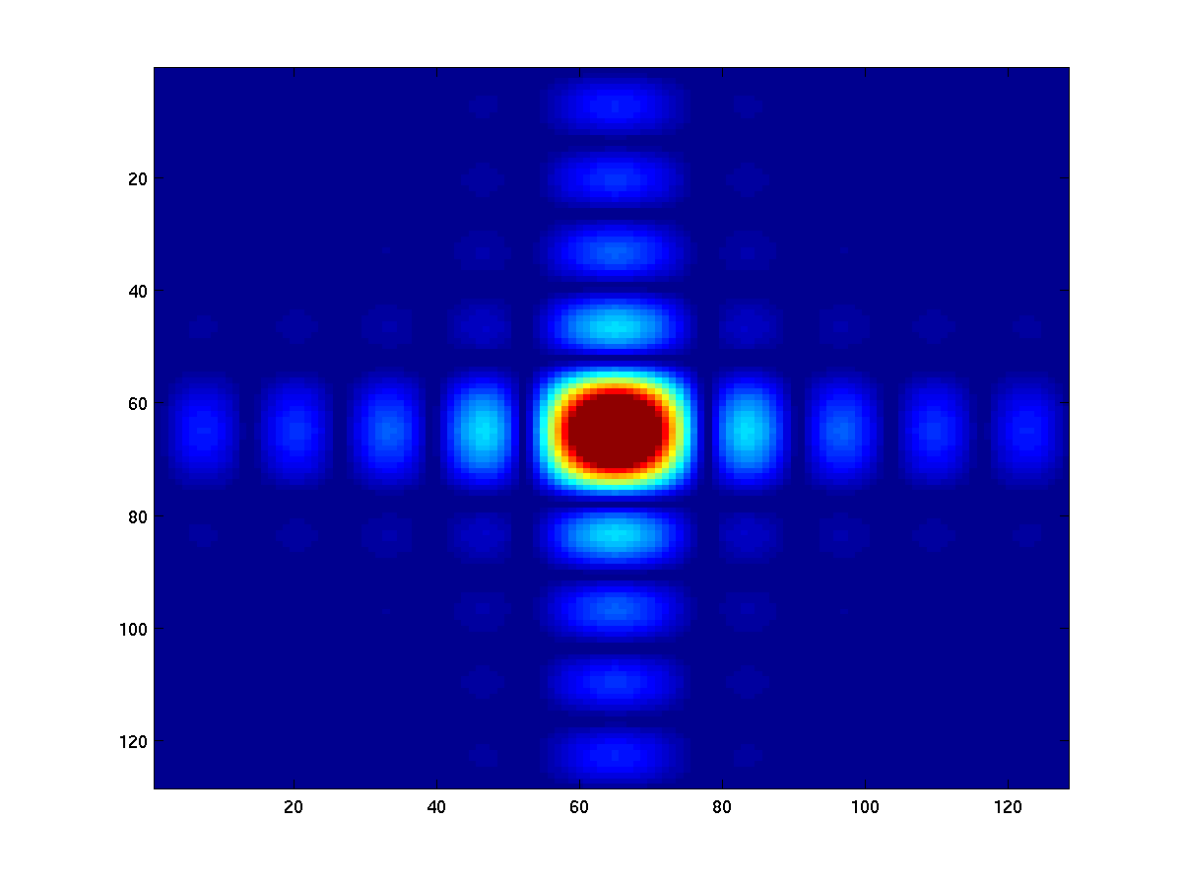
Fourier Transform: shift
It is common to multiply input image by (-1)^{x+y} prior to computing the FT. This shift the center of the FT to (M/2,N/2).
Shift

Slide 44

The Average Value Property
What is the average of all the intensity values of the image?

Slide 45
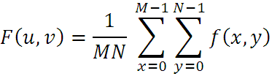
The Average Value Property …
The value of transform at (u, v) = (0, 0)
Which is the average of f(x, y)
f(x, y) is an image
The value of the Fourier transform at origin is equal to the average gray-level of the image

Slide 46
2-D Discrete Fourier Transform
In 2-D case, the DFT pair is:
u=0,1,2,…,M-1 and v=0,1,2,…,N-1
and:
x=0,1,2,…,M-1 and y=0,1,2,…,N-1

Slide 47
Problems
Q) Find the DFT of the following image.
0 | 1 | 2 | 1
1 | 2 | 3 | 2
2 | 3 | 4 | 3
1 | 2 | 3 | 2
Hint:
First do row-wise transformation & then column-wise.

Slide 48
Problems …
Find the DFT of f(x)= {0,1,2,1}

Slide 49
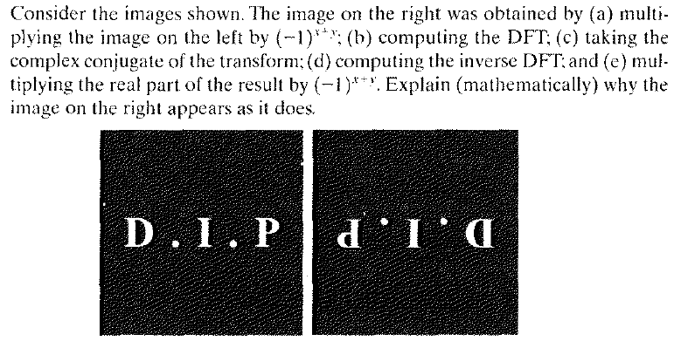
Assignment …

Slide 50

Any Questions ?

